Slide 1
Possible manuscripts for Cannabis pilot project

Slide 2
Study Background & Hypothesis
Whole Cannabis and hemp-derived cannabidiol (CBD) products are reported to have many effects on mental and physical health
The use of edibles to self-treat many conditions, including depression and anxiety, is rising
Optimal dosing conditions to achieve health benefits are poorly understood
Anecdotal reports suggest differences in effects when using edibles and CBD products
Long term goal is to determine if our gut microbiome mediates metabolism of Cannabis and CBD, explaining some differences

Slide 3
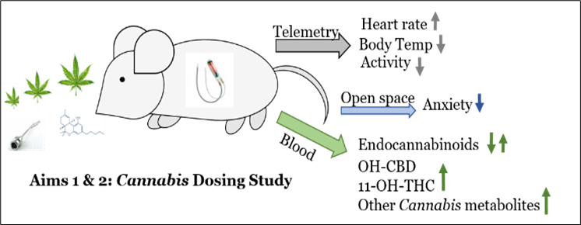
Study Background & Hypothesis
Further, the mechanisms behind the reported effects of CBD and Cannabis on anxiety are unknown
Determine if specific molecular targets are affected
Endocannabinoids and Mood-related neurotransmitters
E.g. Serotonin also known to be affected by the microbiome composition
Few studies on mice using oral feeding of whole or extracted Cannabis
Determine optimal dosing strategy that is non-toxic but results in physiological and/or molecular changes

Slide 4
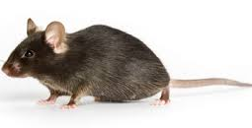
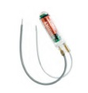
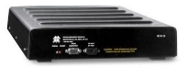
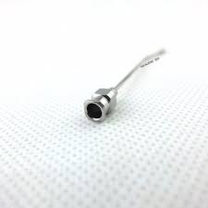
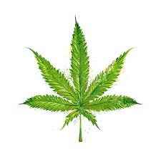
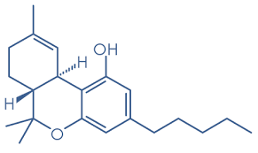
0 3 5 6 8
Birth
Weaning
Telemetry
Treatment*
HR, Body Temp, Activity
Gavage C.s. extract
Free feed C.s.
Mice were dosed every other day during treatment phase (2 weeks). Plasma and tissue were collected at study end.
I.P CBD:THC
Due to limited number (12) of telemetry devices, we had to split the experiment into two phases: Gavage vs IP (January 2020) and Free feeding vs IP (July 2020).

Slide 5
Available Datasets
Neurotransmitters in plasma and brain
Endocannabinoids (eCB) in plasma and brain
CBD/THC of plasma and brain
Adipose for July experiment
Physiological measurements: Body temp, heart rate, activity
LCMSMS methods for CBD/THC- plant material, plasma, brain, adipose
Microbiome for July experiment (very small sample size)
Metabolomics of plasma (brain?) and plant material
Can look for plant compounds in the mouse plasma and brain
Toxicology measurements are likely not usable due to extensive processing time

Slide 6
Possible Manuscript
Effects of Cannabis on brain and plasma neurotransmitters and endocannabinoids in mice
Include Physiological Data
Methods paper too since these haven’t been published

Slide 7
Experimental Design
0 3 5 6 8
Birth
Weaning
Telemetry
Treatment*
Blood and Tissue
Collection
HR, Body Temp, Activity
Gavage C.s. extract
C57BL/6 WT
Free feed C.s.
I.P CBD:THC
Conducted a small pilot study in mice using whole Cannabis, a complex Cannabis extract, and purified THC/CBD, to optimize dosing strategy
Determined physiological effects using telemetry
Measured mood related neurotransmitters and eCB in the plasma and brain
Notes:
To determine an optimal dosing strategy, we performed a 2-week intervention of C57BL/6 WT mice using Cannabis at 3 doses plus control.
C57BL/6 WT mice were given either a crude Cannabis extract via gavage, purified CBD/THC by intraperitoneal (i.p.) injection, or whole Cannabis mixed with nutritional gel.
Telemetry devices were surgically implanted in mice to monitor changes in mouse physiology, including temperature, heart rate, and activity.
In addition to 25 neurotransmitters and 13 endocannabinoids, CBD, THC, and 7 related metabolites in brain, plasma, and adipose tissue were measured using LC/MS/MS.

Slide 8
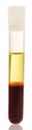
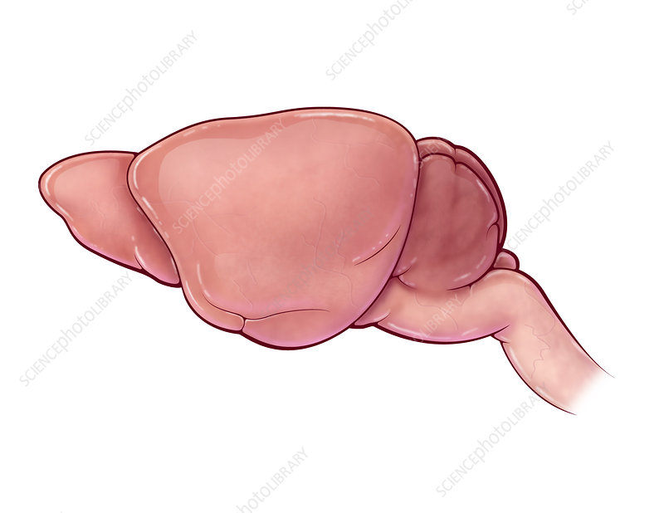
Methods
Mice (n=3 or 4) were dosed every other day during treatment phase
NIDA products; Concentration of CBD and THC based on LC/MS/MS measurements
LC/MS/MS measurements
25 neurotransmitters
13 endocannabinoids,
CBD, THC, and 7 related metabolites
Brain, plasma, and adipose tissue
7 days
eMitter placed
Day 1 2 3 4 5 6 7 8 9 10 11 12 13 14 15
LC/MS/MS: Liquid Chromatography tandem Mass Spectrometry
NIDA: National Institute of Drug Abuse

Slide 10
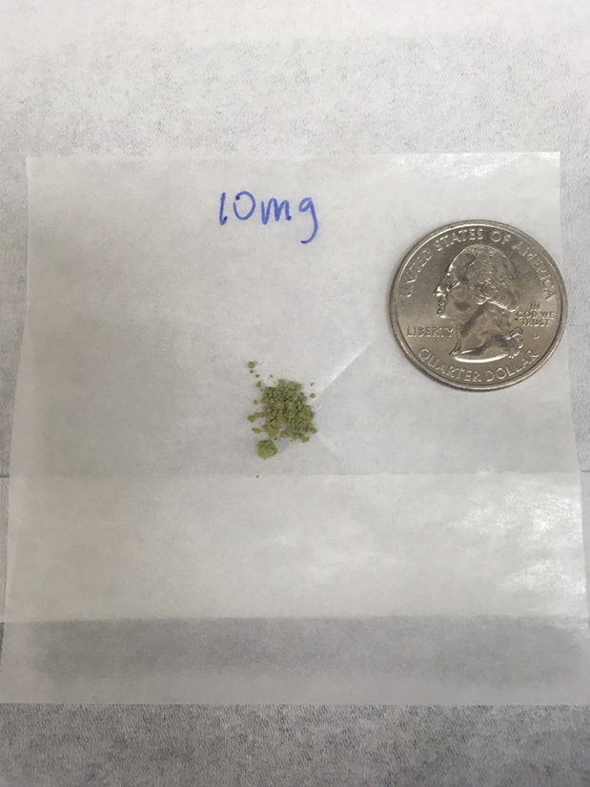
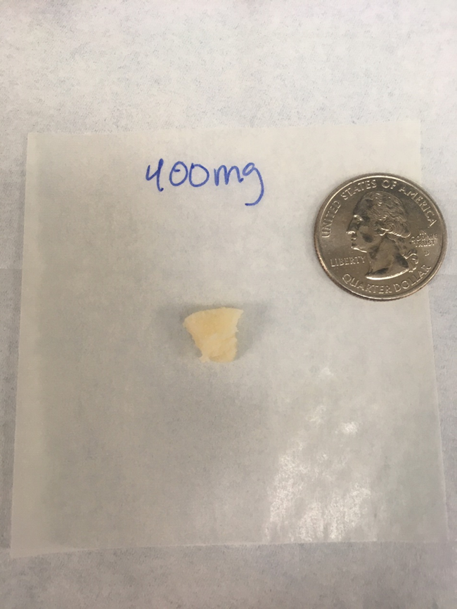
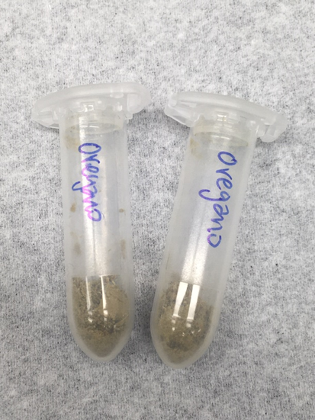
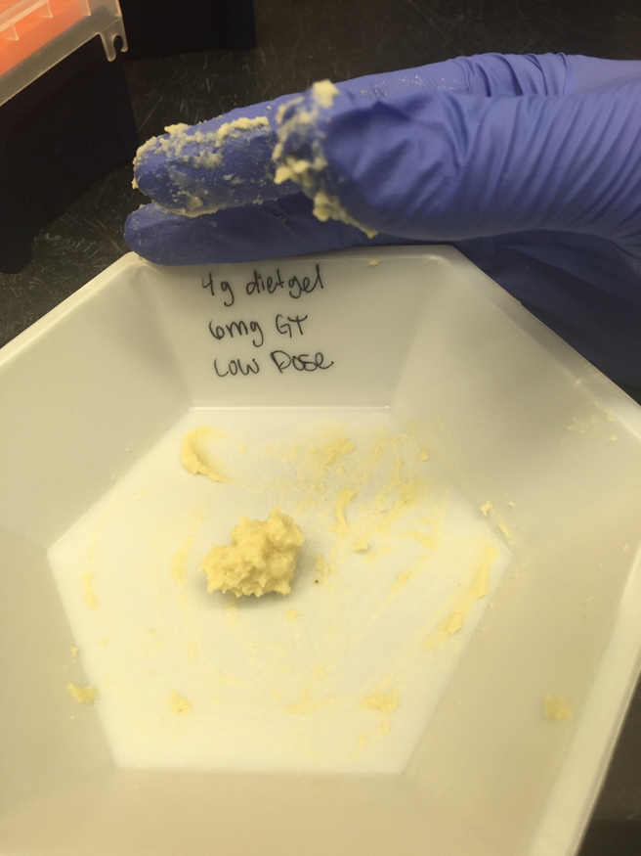
Results
Body Weight
Tox panel for FF and IP July
CBD/THC measurements
In plant material
Plasma and brain
Telemetry
Heart rate
Temperature
Activity
Neurotransmitters and eCB
In plasma and brain

Slide 12
Jan and July IP compare Source of Variation | % of total variation | P value | P value summary | Significant?
Row Factor x Column Factor | 2.003 | 0.5495 | ns | No
Row Factor | 12.14 | <0.0001 | **** | Yes
Column Factor | 8.062 | 0.6977 | ns | No
Subject | 66.22 | <0.0001 | **** | Yes
ALL Groups Compare Source of Variation | % of total variation | P value | P value summary | Significant?
Row Factor x Column Factor | 2.106 | 0.8928 | ns | No
Row Factor | 8.025 | <0.0001 | **** | Yes
Column Factor | 23.57 | 0.2246 | ns | No
Subject | 56.43 | <0.0001 | **** | Yes

Slide 14
Gavage January 2020 Source of Variation | % of total variation | P value | P value summary | Significant?
Row Factor x Column Factor | 2.947 | 0.7554 | ns | No
Row Factor | 8.983 | 0.0163 | * | Yes
Column Factor | 26.16 | 0.2626 | ns | No
Subject | 49.87 | <0.0001 | **** | Yes
IP January 2020 Source of Variation | % of total variation | P value | P value summary | Significant?
Row Factor x Column Factor | 1.219 | 0.9910 | ns | No
Row Factor | 17.74 | <0.0001 | **** | Yes
Column Factor | 52.38 | 0.0116 | * | Yes
Subject | 19.41 | <0.0001 | **** | Yes
Free Feed July 2020 Source of Variation | % of total variation | P value | P value summary | Significant?
Row Factor x Column Factor | 1.134 | 0.8522 | ns | No
Row Factor | 9.164 | <0.0001 | **** | Yes
Column Factor | 2.272 | 0.9176 | ns | No
Subject | 77.43 | <0.0001 | **** | Yes
IP July 2020 Source of Variation | % of total variation | P value | P value summary | Significant?
Row Factor x Column Factor | 0.6077 | 0.7491 | ns | No
Row Factor | 16.48 | <0.0001 | **** | Yes
Column Factor | 0.08044 | 0.9282 | ns | No
Subject | 74.36 | <0.0001 | **** | Yes

Slide 15
Results
Body Weight
Tox panel for FF and IP July
CBD/THC measurements
In plant material
Plasma and brain
Telemetry
Heart rate
Temperature
Activity
Neurotransmitters and eCB
In plasma and brain

Slide 16
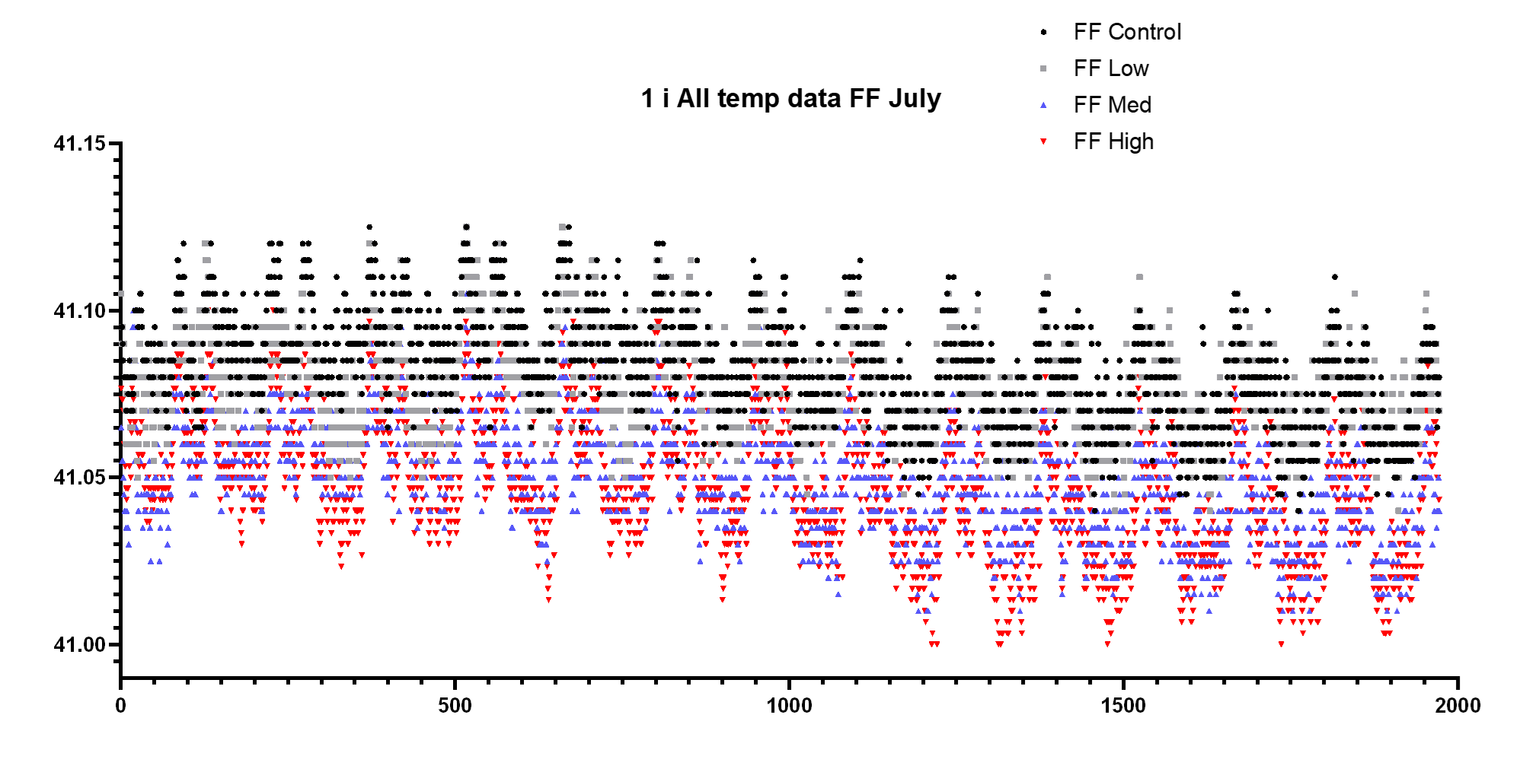
Telemetry: Data Processing & Analysis
eMitter datasets (Vital View software)
Temperature (reading each min)
Heart Rate (reading each min)
Activity (counts per min. Any movement is tallied as a count)
Data was collapsed to generate 6 reading per hour
Data was analyzed using time windows of 1 hour
Pre-dose, Dose, Post-dose 1, Post-dose 2…Post-dose 6
Differences in temperature were assessed using Two-Way ANOVA
Time (over 14 days)
Notes:
The telemetry data was accumulated using essentially GPS devices called eMitters. The datasets were processed using Vital View and then data analyzed in excel and R. Temp, HR, Act. Readings were each minute so a LOT of data over the course of 14 days. We first averaged the data to obtain 6 readings per hour. Then data was further processed so that we could compare 1 hour time windows across the days. For example, we could compare the hour before dosing (called the pre-dose), the hour during dosing, the first hour after dosing, the second hour after dosing, etc.
This chart is a visualization of all readings of temperature of FF animals across the 14 days. This data has not been processed or corrected so we can’t draw any conclusions from it. However, it does show the complexity of the datasets and the normal variability of animals temperature.

Slide 17
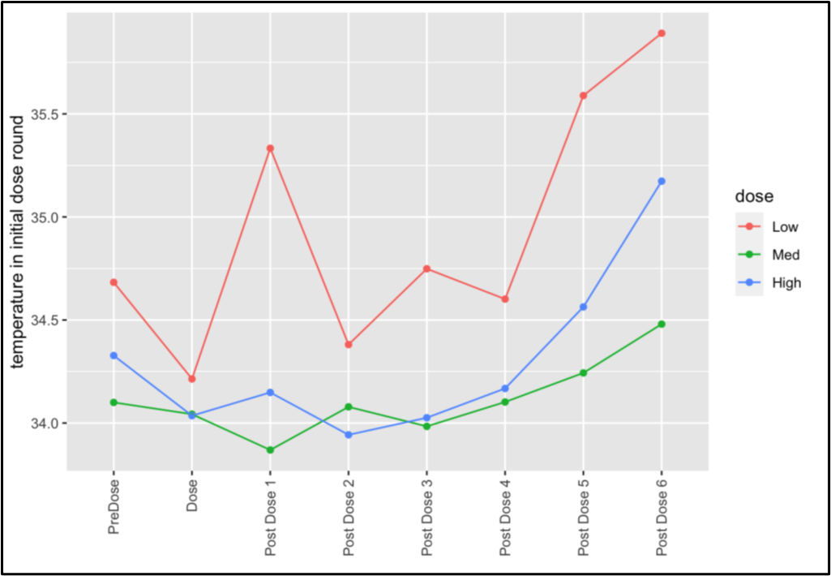
Acute effects on body temperature following initial exposure
Comparison of 1-hour time windows on the first day of treatment was used to examine acute effects on body temperature during initial exposure to Cannabis.
Time and Dose-dependent, acute effects were seen with gavage (interaction effect P = 0.025).
Acute effects were seen with i.p. (dose P = 0.03 and time P < 0.001) but the effect of time on temperature did not differ between doses.
No acute effects were seen with free-feeding.
Effects on body temperature following initial dosing of C.s. extract by gavage.
Notes:
A lot of different ways of analyzing the data. I’m going to show you two ways that we used to determine if there were acute effects on body temperature.

Slide 18
Acute effects on body temperature after chronic exposure
Evaluated by comparing time windows on the final day of dosing.
Cannabis effects were seen for all doses of gavage (P<0.001) and i.p (P<0.001) when time windows were compared.
ANOVA showed significant difference for free feeding, but not dose dependent
Effects on body temperature following final dosing of C.s. extract by gavage.

